Slide 1
ENHANCING WRIST FRACTURE DETECTION IN WRIST X-RAY IMAGES USING DEEP LEARNING MODELS
Faculty of Science and Technology, Dept. of Computer Science
Undergraduate Thesis
Student Name | ID | Contribution
1. MD. MOSTOFA HASIB | 21-44938-2 | 25%
2. ALIF HOSSAIN TALHA | 21-44923-2 | 25%
3. AHMED FARHAN AMIN | 21-44804-1 | 25%
4. NOKIBUL ARFIN SIAM | 21-44793-1 | 25%
Supervisor: | Noboranjan Dey Lecturer, CS, AIUB

Slide 2
Content
Introduction
Problem Statement
Background Research
Research Question
Research Methodology
Findings
Synthesis
Future Work

Slide 3
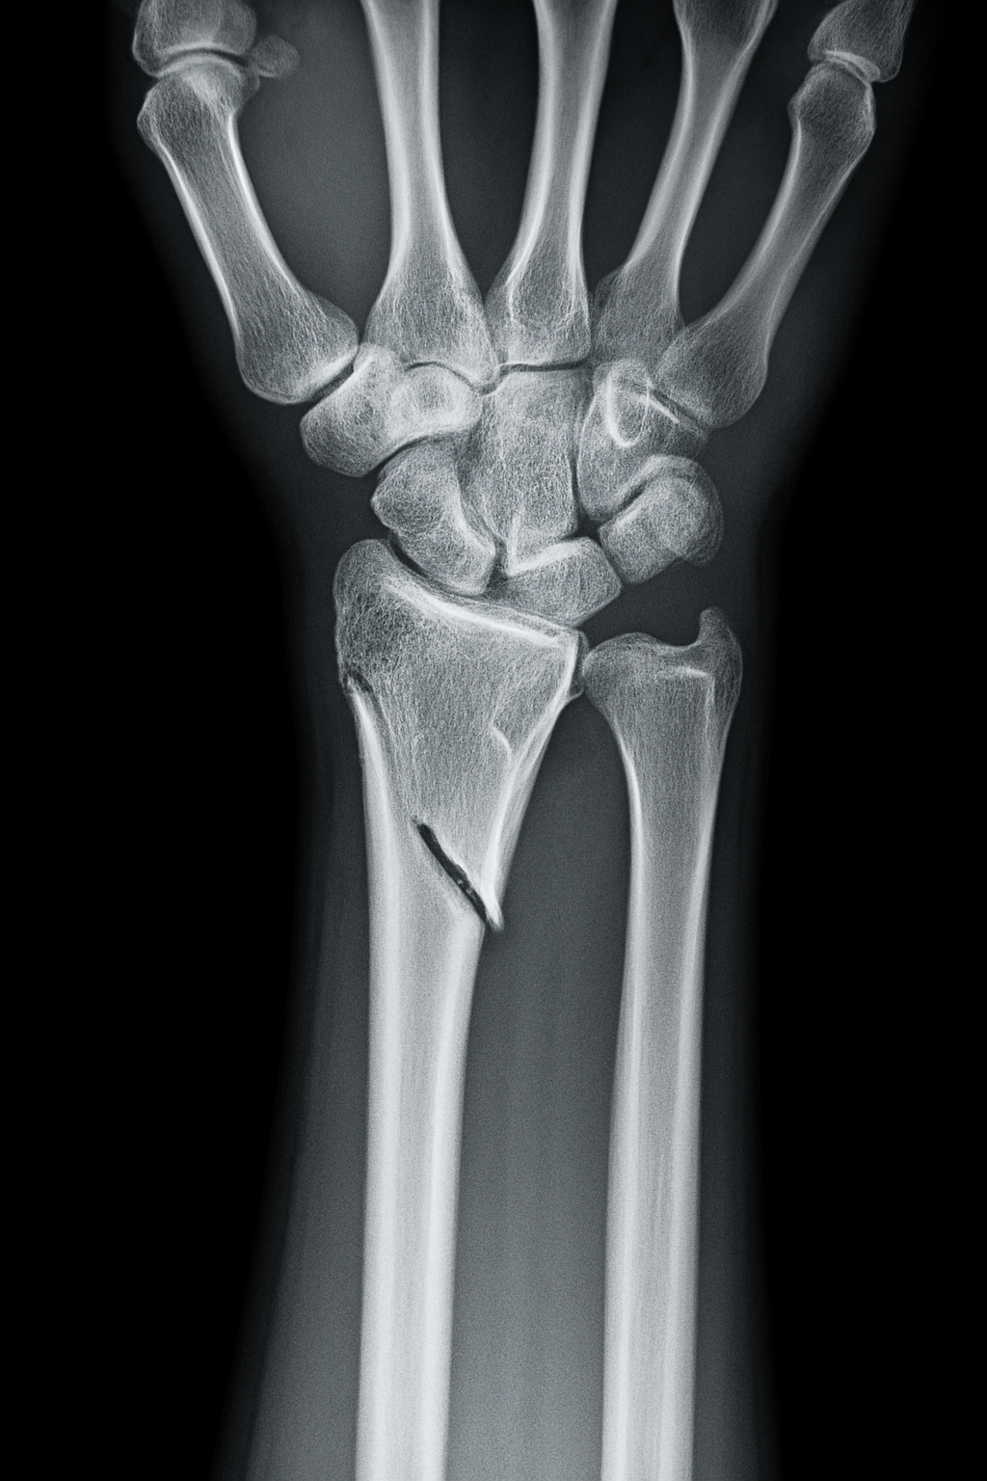
Introduction
What Are Wrist Fractures?
One of the most common orthopedic injuries, often resulting from falls onto an outstretched hand.
Involves breakage of the distal radius and/or ulna; timely diagnosis is critical to prevent long-term disability.
Diagnostic Challenges
Traditional X-ray interpretation is highly dependent on clinician experience.
Subtle fractures or overlapping anatomy can lead to missed or delayed diagnoses.

Slide 4
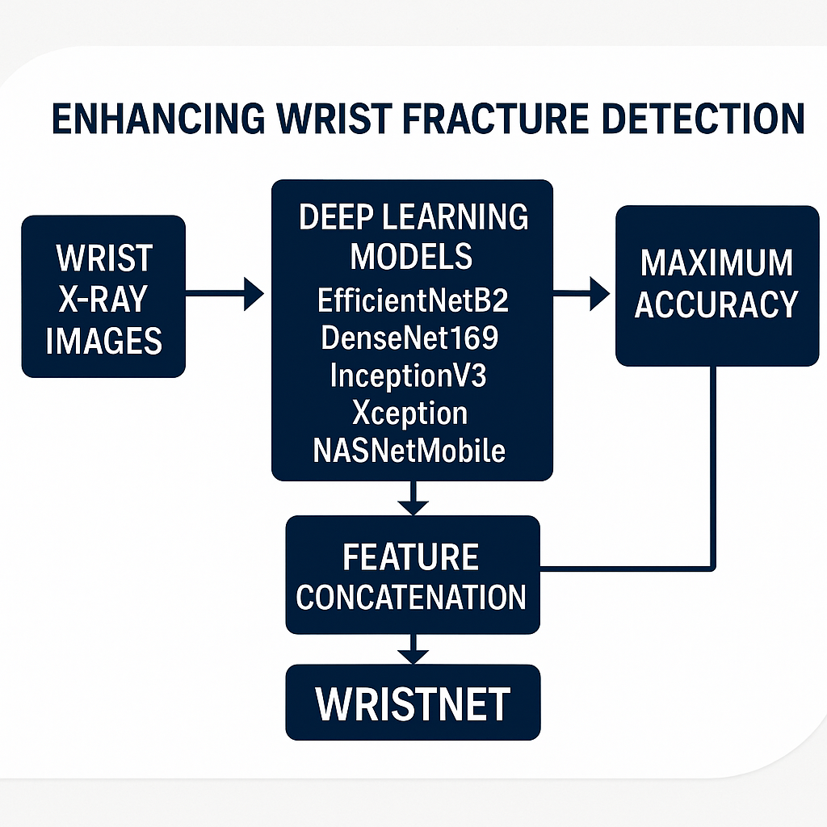
Our Deep-Learning Approach
Benchmark Models: Trained and evaluated EfficientNetB2, DenseNet169, InceptionV3, Xception, and NASNetMobile on wrist X-ray datasets.
Feature Concatenation: Combined features from multiple models to boost detection performance.
Introducing “WristNet”: Proposed a new fused model called "WristNet" for superior wrist fracture detection.
Main Objective & Goal
Objective: Achieve higher accuracy in wrist fracture detection using feature concatenation.
Goal: Deploy “WristNet” as a robust, clinically viable tool to assist radiologists in early and accurate fracture identification.

Slide 5
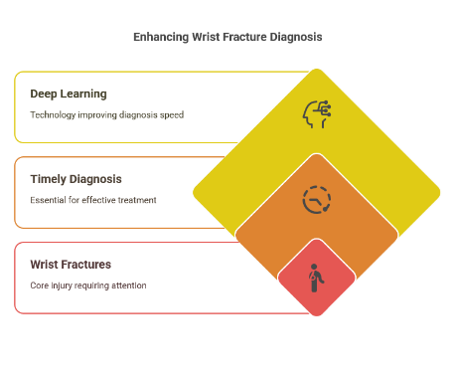
Problem Definition
Limited Labeled Data: X-ray datasets for training AI models are scarce and often imbalanced.
Complex Wrist Anatomy: Overlapping bones make fracture identification difficult, leading to misdiagnosis.
Need for Efficient Models: Standard deep learning models require large datasets, a lightweight CNN is needed for small data scenarios.
Notes:
Presenter Notes (Detailed Explanation)
Data Scarcity in Medical AI:
Deep learning models require large, annotated datasets to generalize well.
Labeled medical images are limited due to privacy concerns, annotation cost, and variability in radiologist interpretations.
Data imbalance (few fracture cases compared to normal cases) can lead to biased model predictions.
Challenges Due to Wrist Anatomy:
The wrist consists of multiple small bones (e.g., radius, ulna, carpal bones) with overlapping structures.
X-ray images may have varying angles, making fracture detection complex.
Fractures can be subtle, requiring high precision to avoid misclassification.
Need for a Lightweight CNN:
Traditional deep learning models are computationally expensive and require large datasets.
A compact yet efficient CNN can optimize performance on small datasets without sacrificing accuracy.
The proposed model aims to enhance diagnostic reliability while reducing computational overhead.

Slide 6
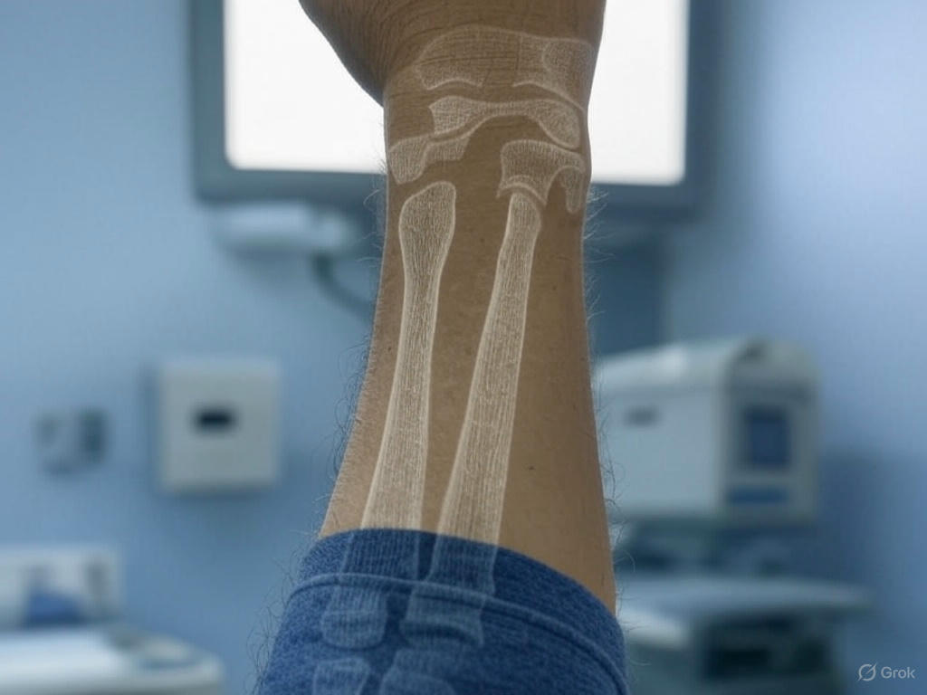
Background Research
Recent advances in deep learning have significantly improved medical imaging analysis, particularly in fracture detection, even with limited datasets. Leveraging these developments, our work focuses on enhancing diagnostic accuracy by using feature concatenation across multiple deep learning models, enabling robust performance on small-scale wrist X-ray datasets through our proposed model, WristNet.

Slide 7
Background Research
Author(s) | Body Part | Images | Methodology | Result
Dibo et al. (2023) | Wrist | 20,327 pediatric X-rays from GRAZPEDWRI-DX | YOLOv7 + Swin Transformer + GAM | mAP of 0.654; 2.6% improvement over
Thian et al. (2019) | Wrist | 7,356 wrist studies (14,614 images; frontal & lateral) | Inception-ResNet | AUC of 0.918 (frontal), 0.933 (lateral); 98.1%
Hardalaç et al. (2022) | Wrist | 542 X-rays from Gazi University Hospital | Faster R-CNN) | AP50 of 0.8639 with the WFD-C ensemble
Wang (2021) | backbone | 3842 X-rays | R-CNN13 network | average precision of 82.1%
Haitaamar (2020) | Wrist | 562 wrist | UNet model | accuracy of 88.54%
Q. Zhou (2022) | Rib | using 420 images | Faster R-CNN method | rate was 71.5%
Shobayo et al. [1] | Wrist | Infrared thermal images; small dataset | CNN-based classification with data augmentation (rotation, shearing); focus on ethical concerns | Sensitivity of 88%; Accuracy of 76%; highlighted limitations in dataset size and accuracy
Rashid et al. [2] | Wrist | X-rays; small dataset | DCNN-LSTM model; hybrid approach with dilated CNN | Accuracy of 88.24%; potential
Lu et al. [1] | Various | 6000 | Dual convolution Ada-ResNeSt backbone; AC- BiFPN for feature detection; | Achieved an AP of 68.4% on MURA-D and 85.6% on DeepLesion with 122ms/image inference.
Ebsim et al. [2] | Wrist | 787 | Random Forest Regression Voting Constrained Local Model (RFCLM) | classification performance: AUC of 0.942 with manual

Slide 8
Research Questions
How can deep learning enhance wrist fracture detection on small datasets?
Can WristNet achieve higher accuracy and efficiency compared to existing deep learning models?
How do data augmentation and hyperparameter tuning affect WristNet’s performance?

Slide 9
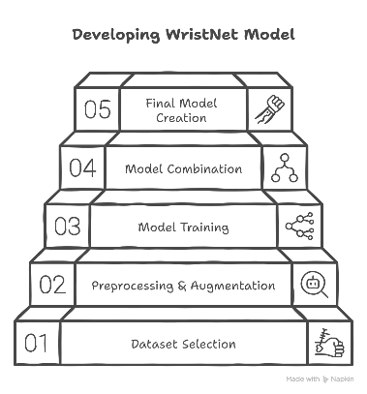
Research Methodology
Data Preparation & Model Training
Used small-scale labeled wrist X-ray dataset.
Preprocessing & Augmentation: Normalization, resizing, rotation, flipping.
Trained 5 CNN models: EfficientNetB2, DenseNet169, InceptionV3, Xception, NASNetMobile.
Combined top-performing models using feature concatenation.
Built final model: WristNet.

Slide 10
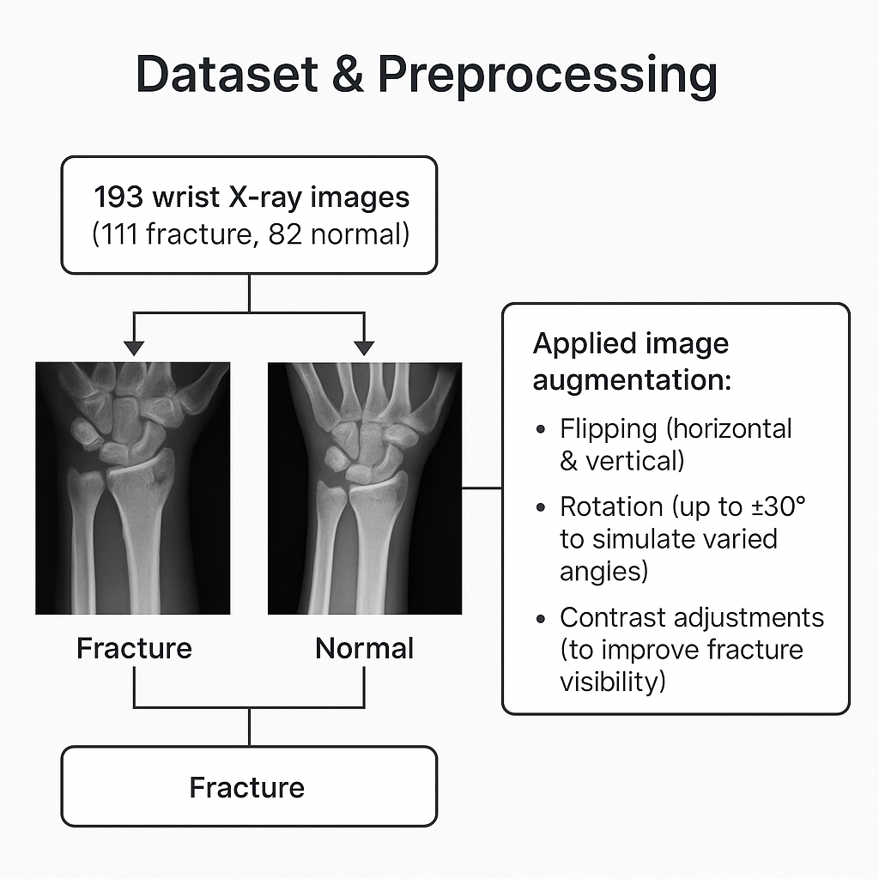
Dataset & Preprocessing
193 wrist X-ray images (111 fracture, 82 normal) from various platforms, and paper.
Applied image augmentation
Flipping (horizontal & vertical)
Rotation (up to ±30° to simulate varied angles)
Contrast Adjustments (to improve fracture visibility)

Slide 11
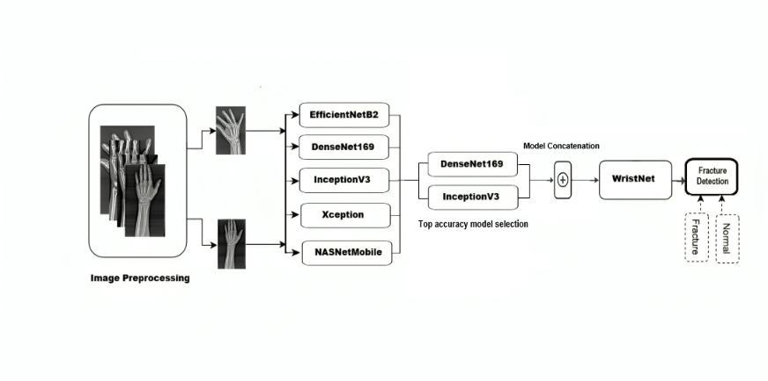
WristNet Architecture Overview

Slide 12
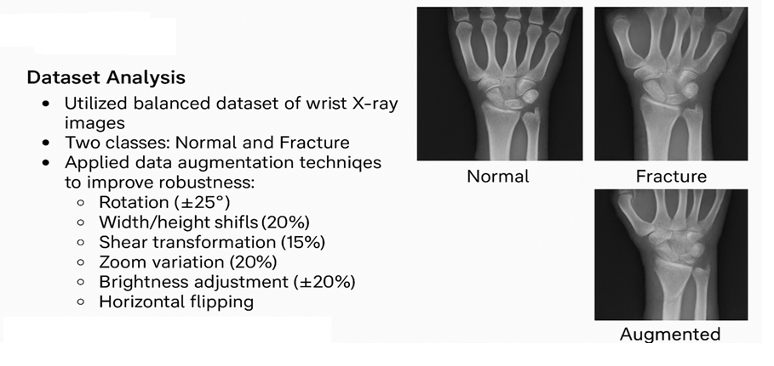
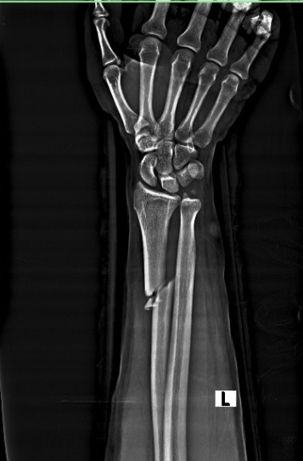
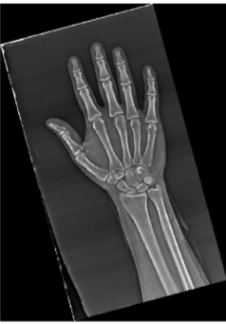
Findings

Slide 13
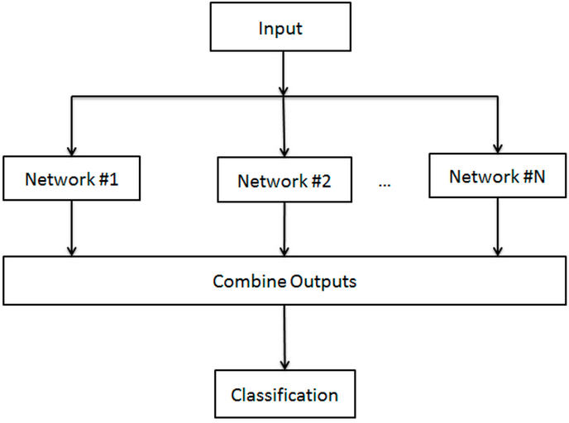
Findings
Model Performance Evaluation Utilized:
Each base model trained independently on the dataset
Hyperparameter optimization performed for each model
Evaluation metrics: Accuracy, Precision, Recall, F1-Score
Cross-validation employed to ensure reliability

Slide 14
Results
Individual Model Performance:
Model | Accuracy | Precision | Recall | F1-Score
WristNet | 97.50% | 94.44% | 99.00% | 99.62%
DenseNet169 | 95.00% | 96.8% | 98.1% | 97.4%
InceptionV3 | 90.00% | 91.7% | 93.2% | 92.4%
Xception | 85.00% | 84.3% | 85.6% | 84.9%
NASNetMobile | 85.00% | 83.9% | 86.2% | 85.0%
EfficientNetB2 | 70.00% | 68.5% | 71.2% | 69.8%
Table : Performance of Individual Deep Learning Models
WristNet demonstrated the highest true positive rate.
EfficientNetB2 showed the highest false negative rate.
InceptionV3 and DenseNet169 provided balanced performance.

Slide 15
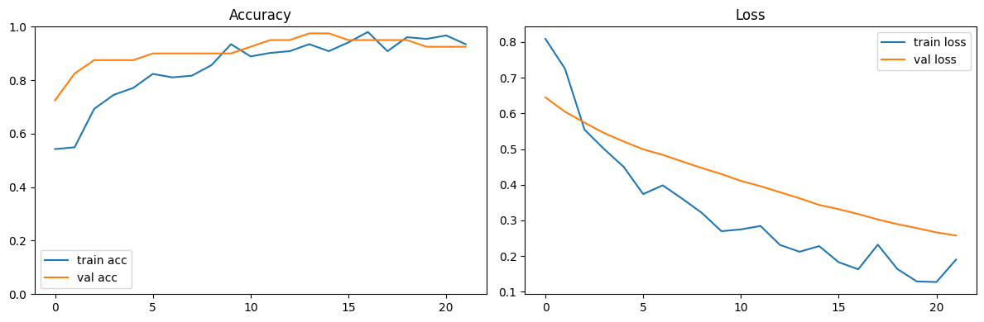
Results
Accuracy % Loss Curve of WristNet

Slide 16
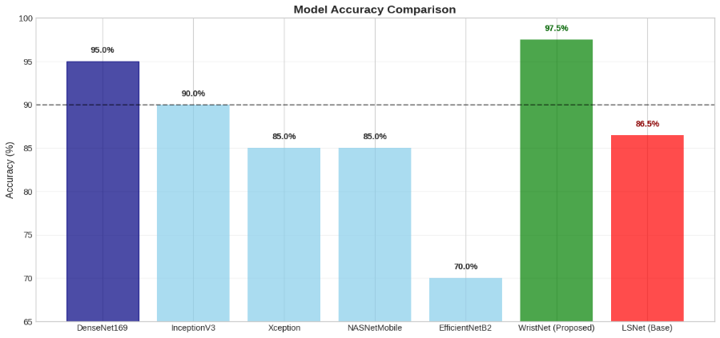
Results

Slide 17
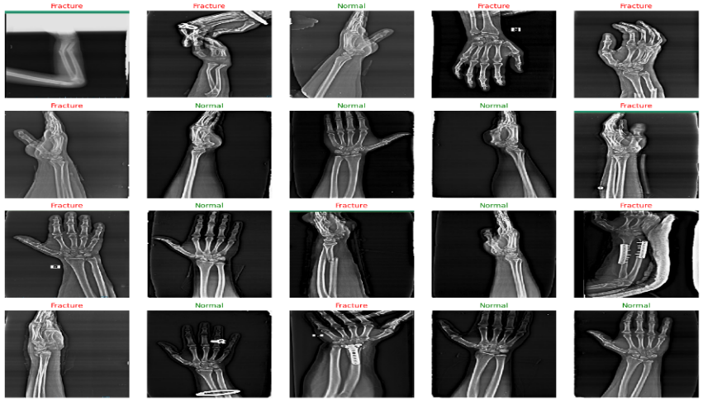
Prediction Samples

Slide 18
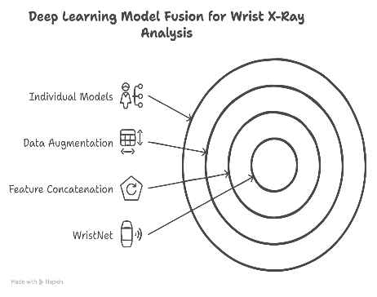
Synthesis
We used five deep learning models: EfficientNetB2, DenseNet169, InceptionV3, Xception, and NASNetMobile on a small wrist X-ray dataset.
Instead of using ensemble voting, we applied feature concatenation to combine the strengths of these models into a single fused model.
This fused model, called WristNet, achieved higher accuracy than any individual model, even with limited data.
Simple augmentations like rotation and flipping were used to improve generalization.
Our approach proves that even with a small dataset, deep learning can be powerful when feature-level fusion is applied correctly.

Slide 19
Comparison [WristNet vs LSNet]
Key Improvements (WristNet vs. LsNet):
Accuracy: +11.0% (97.5% vs. 86.5%)
Precision: +9.14% (better at correctly identifying fractures)
Recall: +11.8% (better at detecting all fracture cases)
Model | Accuracy | Precision | Recall
LSNet | 86.5% | 85.3% | 87.2%
WristNet | 97.50% | 94.44% | 99.00%

Slide 20
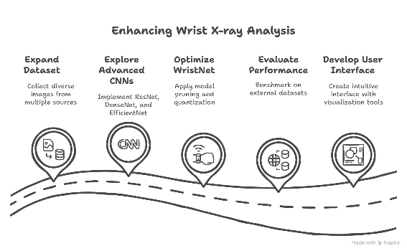
Future Work
Expand the dataset with more diverse wrist X-ray images.
Explore other advanced CNN architectures for further improvement.
Optimize WristNet for real-time clinical deployment.
Evaluate performance on external/public datasets for generalization.
Develop a user-friendly interface for radiologists.

Slide 21
Conclusion
WristNet, a concatenation of DenseNet169 and InceptionV3, achieved 97.50% accuracy, surpassing LSNet by 11%. We applied feature concatenation to combine the strengths of these models into a single fused model.
This work reflects our contribution to advancing deep learning in medical imaging, with the goal of improving diagnostic accuracy and efficiency in clinical practice.

Slide 22
References
DeepLOC: Deep Learning-based Bone Pathology Localization and Classification in Wrist X-ray Images https://paperswithcode.com/paper/deeploc-deep-learning-based-bone-pathology
Convolutional Neural Networks for Automated Fracture Detection and Localization on Wrist Radiographs https://pubmed.ncbi.nlm.nih.gov/33937780/
Fracture Detection in Wrist X-ray Images Using Deep Learning-Based Object Detection Models https://www.mdpi.com/1424-8220/22/3/1285
Wang, M. et al. Parallelnet: Multiple backbone network for detection tasks on thigh bone fracture. Multimed. Syst. 27, 1091–1100 (2021).
Guan, B., Yao, J., Zhang, G. & Wang, X. Tigh fracture detection using deep learning method based onnew dilated convolutional feature pyramid network. Pattern Recogn. Lett. 125, 521–526 (2019).
T. Weikert et al., "Assessment of a deep learning algorithm for the detection of rib fractures on whole-body trauma computed tomography," vol. 21, no. 7, p. 891, 2020.
Z. N. Haitaamar and N. Abdulaziz, "Detection and semantic segmentation of rib fractures using aconvolutional neural network approach," in 2021 IEEE Region 10 Symposium (TENSYMP), 2021, pp. 1-4: IEEE.
L. Jin et al., "Deep-learning-assisted detection and segmentation of rib fractures from CT scans:Development and validation of FracNet," vol. 62, 2020.
Shobayo, O., Saatchi, R., & Ramlakhan, S. (2024). Convolutional neural network to classify infrared thermalimages of fractured wrists in pediatrics. Healthcare, 12(4), 994.
Rashid, T., Zia, M. S., Najam-ur-Rehman, et al. (2023). A minority class balanced approach using the DCNN-LSTM method to detect human wrist fracture. Life, 13(1), pp. 133. https://doi.org/10.3390/life13010133
Lu, S., Wang, S., & Wang, G. (2022). Automated universal fractures detection in X-ray images based on deeplearning approach. Multimedia Tools and Applications, 81(44487-44503).
Ebsim, R., Naqvi, J., & Cootes, T. (2017). Fully automatic detection of distal radius fractures fromposteroanterior and lateral radiographs. Lecture Notes in Computer Science, 10550, 91-98.

Slide 23


Slide 24
Thank You

